Slide 1
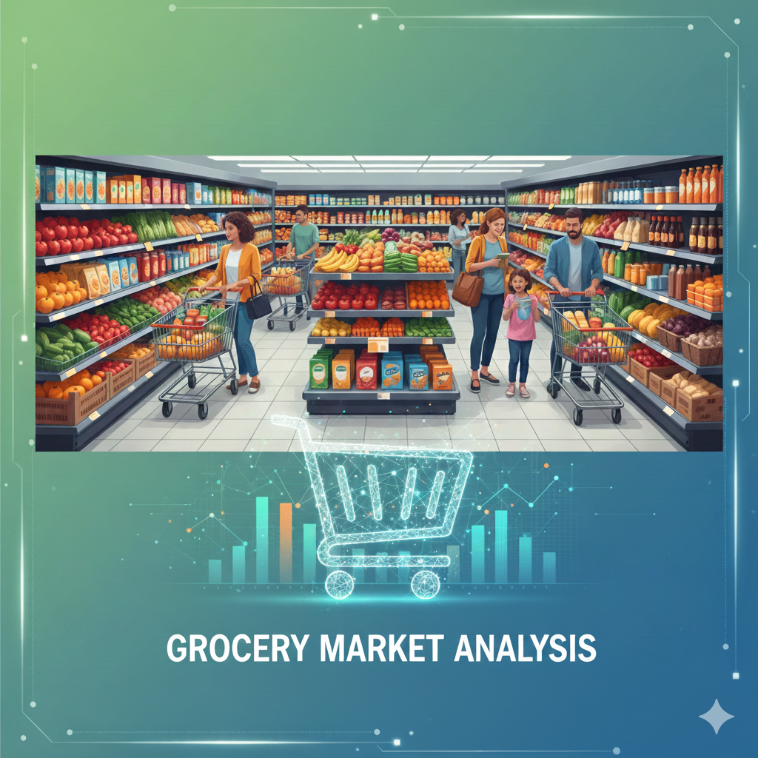

Grocery Market Analysis Using MySQL
Presented By
PAVAN AHIRE

Slide 2

Objective of the Project
Design & Implement Database: Build a relational database for managing suppliers, customers, products, employees, and orders.
Data Retrieval & Manipulation: Use SQL queries (joins, subqueries, aggregations) to extract meaningful information.
Business Insights: Analyse customer behaviour, sales trends, product performance, and supplier contributions.
Decision Support: Provide insights to improve revenue, inventory management, and employee efficiency.
Hands-on SQL Practice: Strengthen skills in schema design, query optimization, and data-driven problem solving.

Slide 3
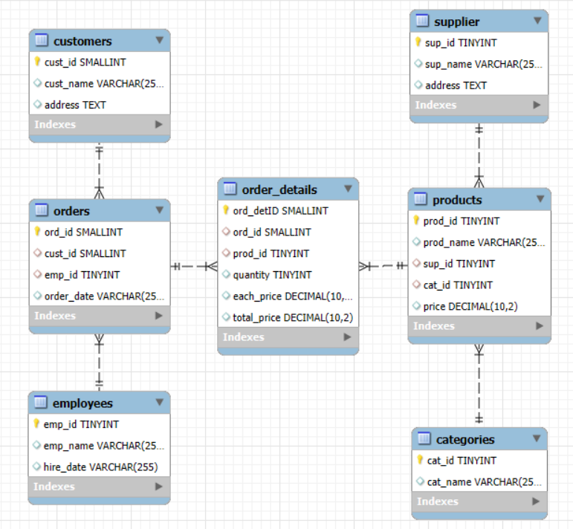
Entity Relational Diagram (ERD)
Customers – Store customer details; one customer can place many orders.
Employees – Manage orders; one employee can handle many orders.
Orders – Record customer orders, linked to customers and employees.
Order_Details – Capture product quantity and pricing for each order.
Products – Store product info, linked to suppliers and categories.
Suppliers – Provide products; one supplier can supply many items.
Categories – Define product groups; one category can contain many products.

Slide 4
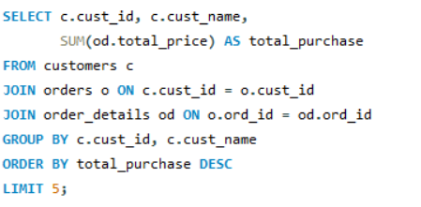
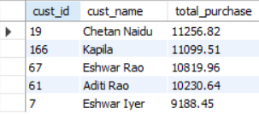
Key analysis questions (use cases)
1. Who are the top 5 customers by total purchase amount?
OUTPUT:
Observation
The analysis shows that Chetan Naidu is the top customer, followed by Kapila and Eshwar Rao, each with purchases above 10K.
This shows that a few loyal customers make a large share of revenue.

Slide 5
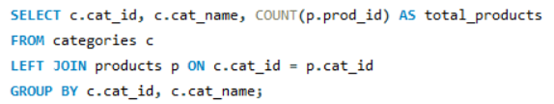
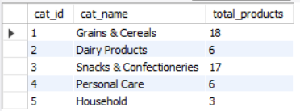
2. How many products exist in each category?
OUTPUT:
Observation
The results show that Grains & Cereals and Snacks & Confectioneries dominate with the highest number of products. Meanwhile, Household has the least with only 3 products. This means the store is more focused on food items compared to household or personal care.

Slide 6
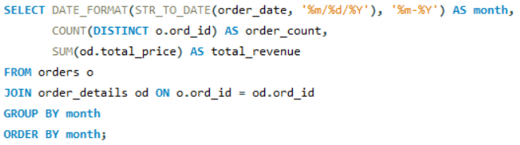
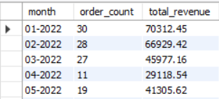
3. What are the monthly trends in order volume and revenue?
OUTPUT:
Observation
January had the highest sales, followed by February. Sales dropped in March and reached the lowest in April, but slightly improved in May. Overall, there is a downward trend in orders and revenue during this period.

Slide 7
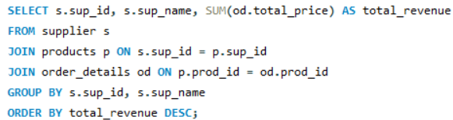
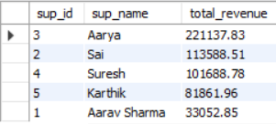
4. Which suppliers contribute the most to total product sales (by revenue)?
OUTPUT:
Observation
The results show that Aarya is the top supplier with the highest revenue of over 2 lakh, which is much higher than the others. This means the business is heavily dependent on one main supplier, which can be risky.

Slide 8
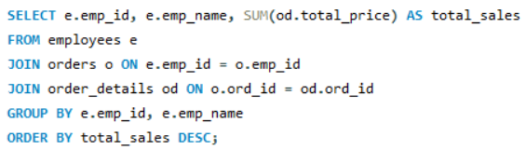
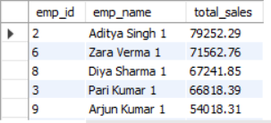
5. What is the total sales value processed by each employee?
OUTPUT:
Observation
I also checked the total sales value handled by each employee.
Aditya Singh leads with the highest sales, followed by Zara Verma and Diya Sharma. This shows that a few employees are driving most of the sales performance.

Slide 9
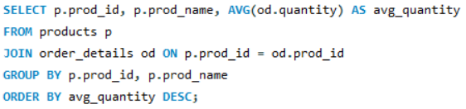
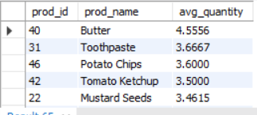
6. What is the average quantity ordered per product?
OUTPUT:
Observation
The results show that Butter has the highest average quantity per order, followed by Toothpaste and Potato Chips. This means these items are purchased more frequently in larger quantities than others.

Slide 10
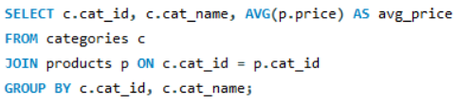
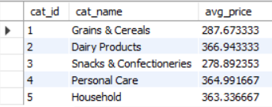
7. What is the average price of products by category?
OUTPUT:
Observation
The results show that Dairy and Personal Care items are more expensive, while Grains and Snacks are cheaper. This is expected because essential food items usually cost less, while specialty and personal care products are priced higher.

Slide 11
Final Business Insights and Key Recommendations
Final Business Insights:
A small group of top customers contributes the majority of revenue.
Grains & Snacks categories dominate the product mix.
Business is highly dependent on a few key suppliers.
Certain products and employees consistently drive higher sales.
Key Recommendations:
Launch loyalty programs to retain high-value customers.
Expand weaker categories like Household and Personal Care.
Onboard more suppliers to reduce dependency risks.
Reward top-performing employees and ensure stock of high demand products.

Slide 12
Conclusion
In conclusion, this project helped me design and analyze a Grocery Store Management System using SQL.
I learned how to create tables, write queries, and generate insights.
The analysis highlighted customer behavior, product performance, supplier dependency, and employee contributions.
Overall, it showed how SQL can help in making better business decisions.

Slide 13


THANK YOU
connect with me on

